Slide 1

USWDS Monthly Call
November 2024

Slide 2

Hi!
Thanks for being here!

Slide 3
Agenda
Featured sites
Product updates
The next generation of USWDS
Q&A

Slide 4
Featured sites

Slide 5
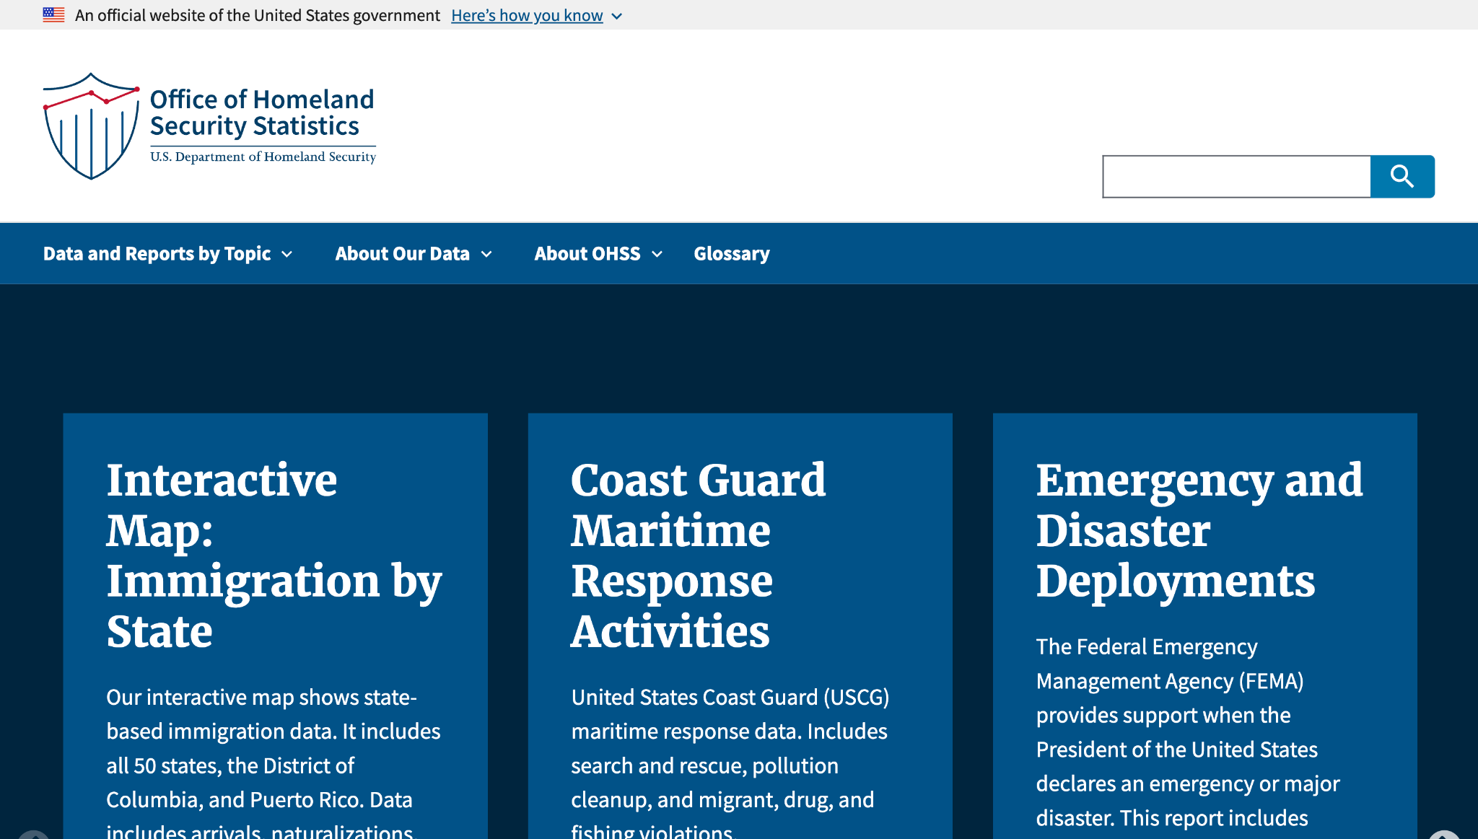
Office of Homeland Security Statistics
ohss.dhs.gov
Notes:
TK

Slide 6
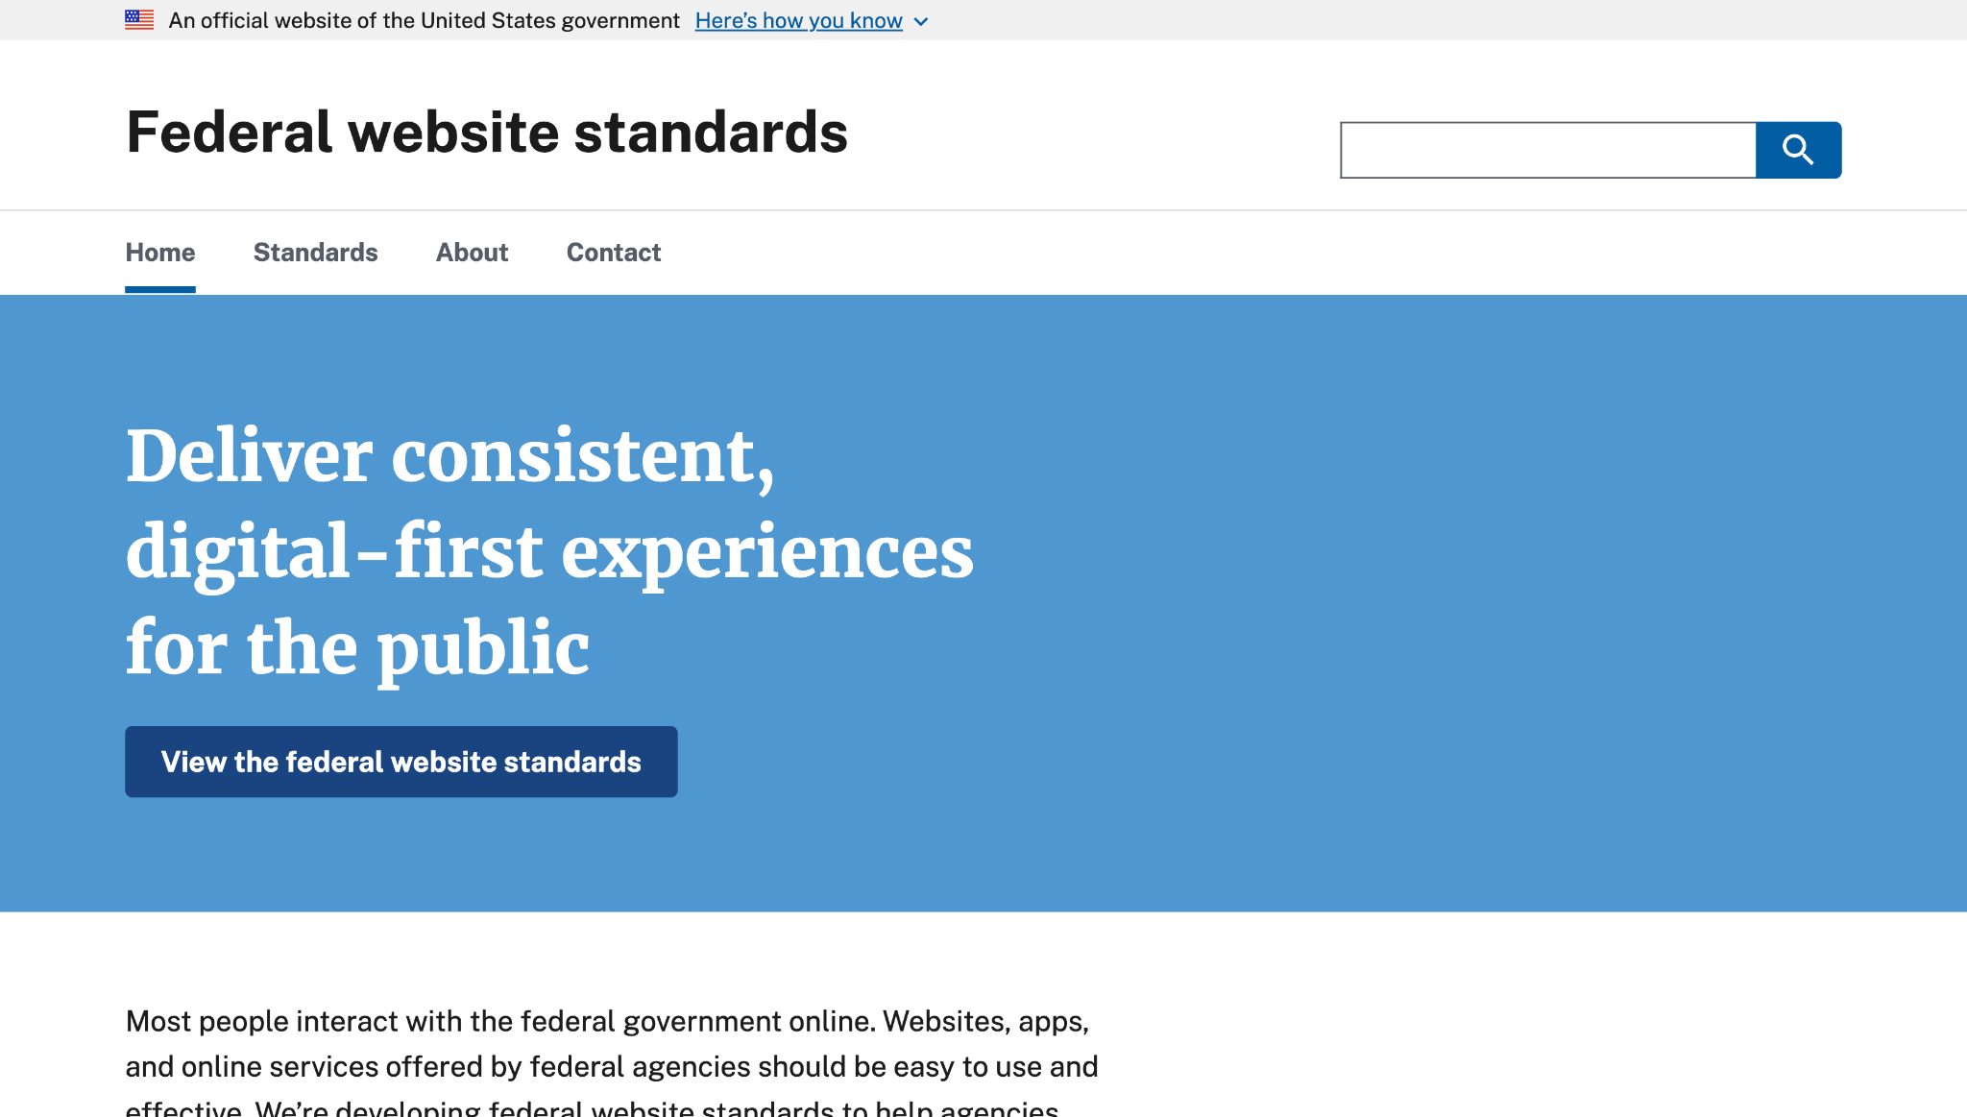
Federal Web Standards
standards.digital.gov
Notes:
TK

Slide 7
Great work!

Slide 8
Product updates

Slide 9
USWDS 3.10.0
Out now!

Slide 10
Notable updates in USWDS 3.10.0
Updated the order of combo box search results. The component now displays options that start with the query at the top of the list, followed by options that contain the query.
Updated the time picker hint text to improve clarity.
Fixed a bug that caused file input image previews to break when a Content Security Policy is enabled.

Slide 11
USWDS Compile 1.2.1
Coming soon

Slide 12
New accessibility test pages
Memorable date, Time picker, File input
Next: Collection, Summary box, Icon list, Button group, and Process list

Slide 13
USWDS for Figma
Initial Beta version out now
figma.com/community

Slide 14
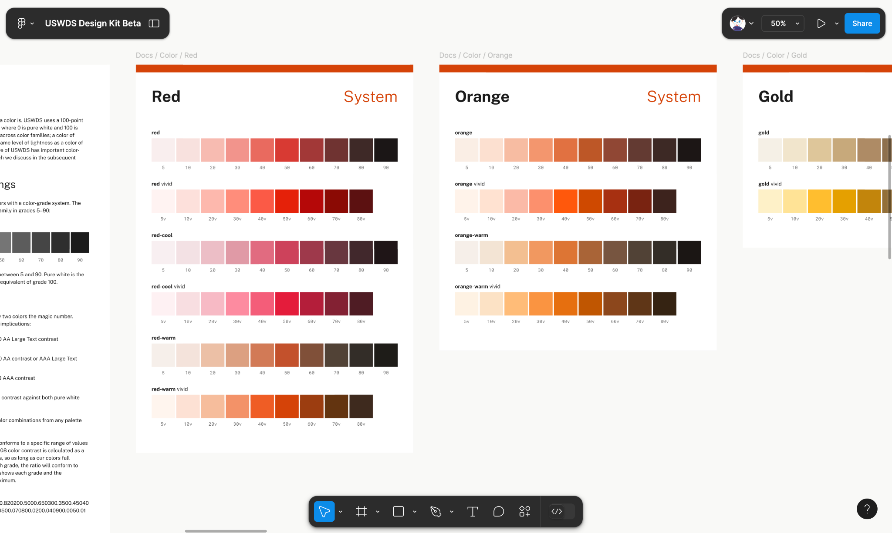
Tokens, variables, and complete documentation

Slide 15
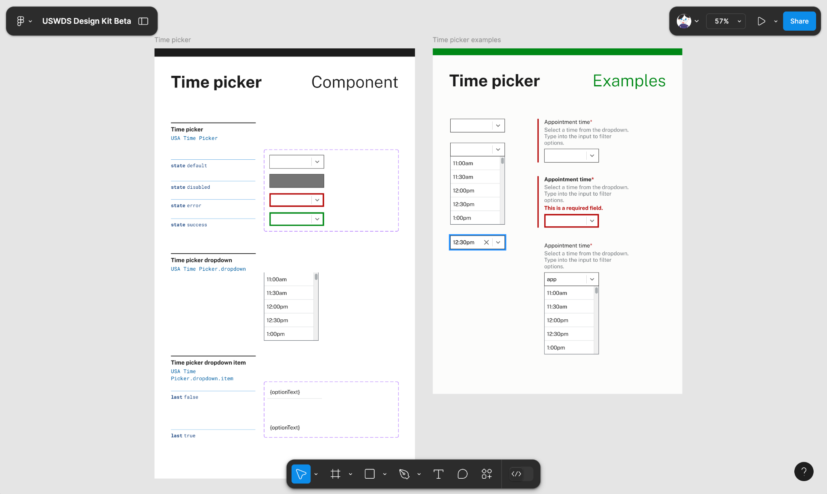
42 USWDS components with examples

Slide 16
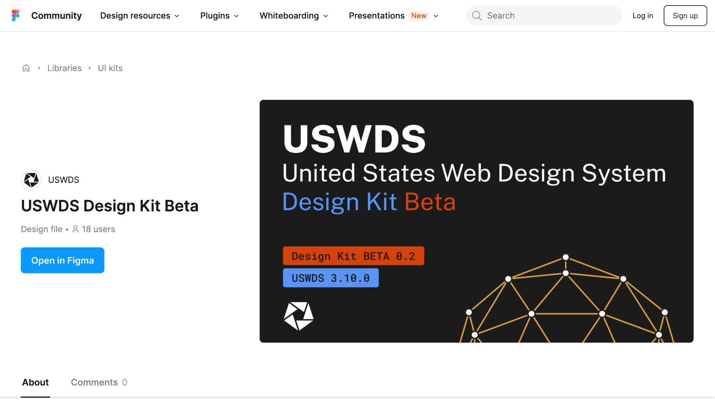
In public beta now. Available at the Figma community page.

Slide 17
Public discussions
Active component proposals: Spinner
Active pattern proposals: Prefilled information
Active discussions: USWDS with Next.js and SSR, Inclusive experiences beyond visual design
Accessibility: Autocomplete attribute
Q&A: October monthly call

Slide 18
Sunsetting v1 documentation site
Decommissioning at the end of 2024

Slide 19
GitHub Contributions
Signed commits

Slide 20
The next generation of the design system

Slide 21
Anne Petersen
they/them
Experience Design Lead USWDS

Slide 22
Matt Henry
he/him
Engineering Lead USWDS

Slide 23
Tension and change

Slide 24
Change

Slide 25
The long view

Slide 26
Design is adaptation

Slide 27
Helping teams do design work

Slide 28
Tension

Slide 29
A tension between difference and commonality

Slide 30
A tension between customization and configuration

Slide 31
A tension between present needs and future needs

Slide 32
DynamicTension
Dynamic
?

Slide 33
The current USWDS codebase is showing its age

Slide 34
What do you need to know to use USWDS? Sass? BEM?

Slide 35
Our goal
Make it easier to adopt the design system and stay up to date

Slide 36
Folks use the design system in all kinds of ways

Slide 37
Whose way is the right way?

Slide 38
Wishy-washy

Slide 39
Shaping

Slide 40
Values made tangible

Slide 41
Values made practice

Slide 42
👀
How we perceive the world

Slide 43
Adapt and evolve

Slide 44
Our mission
Shaping the future of government digital services

Slide 45
Our vision
Empowered and supported
digital service teams. Familiar and easy-to-use digital services.

Slide 46
Our polestar
We help government teams align, design, and keep their websites and services up to date

Slide 47
USWDS Product Values
Design is adaptation.
Compliance is the baseline.
Strengthen connections.
Easier earlier.
Be a good steward.

Slide 48
USWDS Engineering Values
Embrace the platform.
Support UX with developer experience.
We’re a layer.
Write plain-language code.

Slide 49
The (original) World Wide Web

Slide 50
Public domain

Slide 51
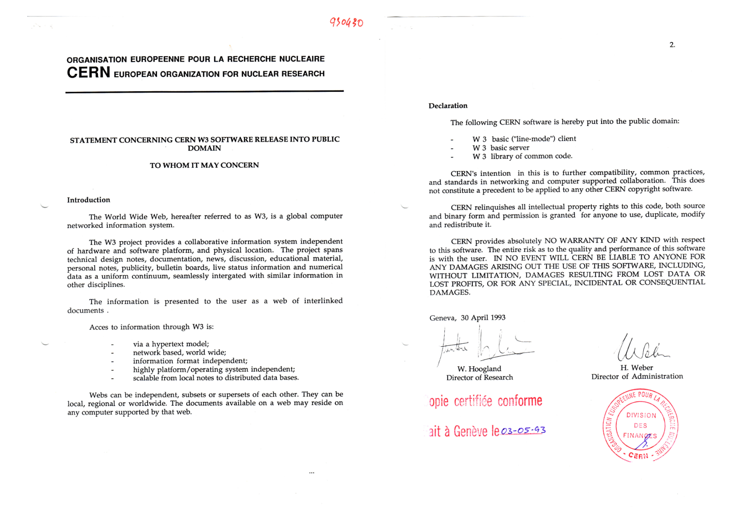
Open collaboration for the benefit of society

Slide 52
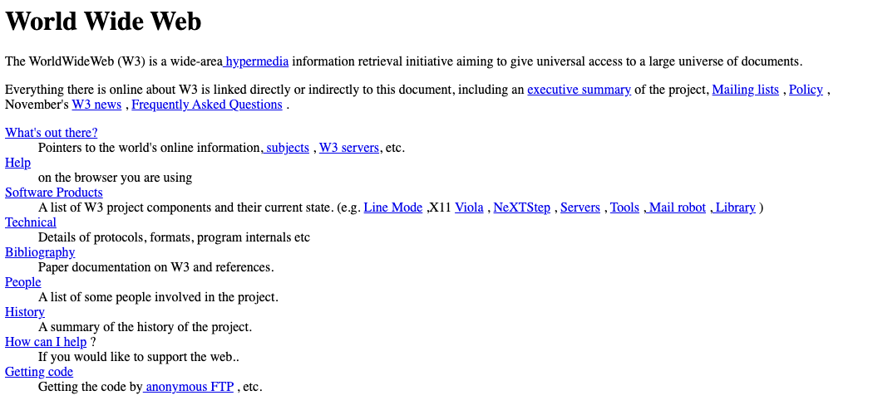
World Wide Web

Slide 53
What's out there?

Slide 54
Meta
Meta
Meta
Meta
Meta
Meta
Meta
Meta
Meta
Meta
Meta
Meta
Meta
Meta
Meta
Meta

Slide 55
It builds upon itself

Slide 56
Open, available, flexible, remixable… modular

Slide 57
anticipate 👀

Slide 58
United

Slide 59
What we’re hearing

Slide 60
The story of USWDS Web Components:
Simpler API, less maintenance, and fewer dependencies

Slide 61
Tension and tradeoffs

Slide 62
Adopt and adapt?

Slide 63
Web Components make this value proposition more complicated.

Slide 64
Great until they aren’t great

Slide 65
Existential risk on both sides

Slide 66
Continue to improve both ways

Slide 67
Core code and Web Components

Slide 68
Both products co-evolving together

Slide 69
Let’s simplify

Slide 70
USWDS Elements

Slide 71
USWDS Core

Slide 72
A little seed

Slide 73
Core and Elements

Slide 74
No old and new. Just different angles.

Slide 75
How can one set of design tokens support both?

Slide 76
USWDS Tokens

Slide 77
Canonical data, flexible output

Slide 78
Standalone integrated products

Slide 79
USWDS Utilities

Slide 80
More… utility?

Slide 81
Each domain can evolve at its own pace

Slide 82
Semantic versioning.
Really for real.

Slide 83
Not USWDS 4.0

Slide 84
USWDS Core 4.0
USWDS Elements 1.0
USWDS Tokens 1.0
USWDS Utilities 1.0

Slide 85
A united model

Slide 86
Making it work

Slide 87
Usage, infrastructure, priorities

Slide 88
Mix and match

Slide 89
Elements as the starting point

Slide 90
Extensible Elements

Slide 91
Eject
Eject
Eject
Eject
Eject
Eject

Slide 92
Modularization
Modularization
Modularization
Modularization

Slide 93
Tools and targets

Slide 94
Dependencies
Dependencies
Dependencies
Dependencies
Dependencies
Dependencies

Slide 95
Moving to web standard CSS

Slide 96
But that doesn’t mean we no longer support Sass

Slide 97
For teams, moving to Core 4.0 shouldn’t be a big lift

Slide 98
An Elements component will precede breaking changes to a Core component

Slide 99
Continuity matters to us

Slide 100
A bias toward shipping

Slide 101
Architectural Decision Records

Slide 102
What to expect in 2025

Slide 103
A more modern and more resilient design system

Slide 104
A priority shift

Slide 105
USWDS Core: Interop with Elements and Tokens
USWDS Elements: Fewer, simpler, Standards
USWDS Tokens: Powering Core and Elements
USWDS Utilities: Cloning Sass-based system
Website: Resource for getting up to speed

Slide 106
Not old and new. United.

Slide 107
Q&A
Notes:
DW

Slide 108
Next month
December: Federal Website Standards
#uswds-public
github.com/uswds
designsystem.digital.gov
Notes:
DW

Slide 109
Disclaimer: All references to specific brands, products, and/or companies are used only for illustrative purposes and do not imply endorsement by the U.S. federal government or any federal government agency.

